Slide 1
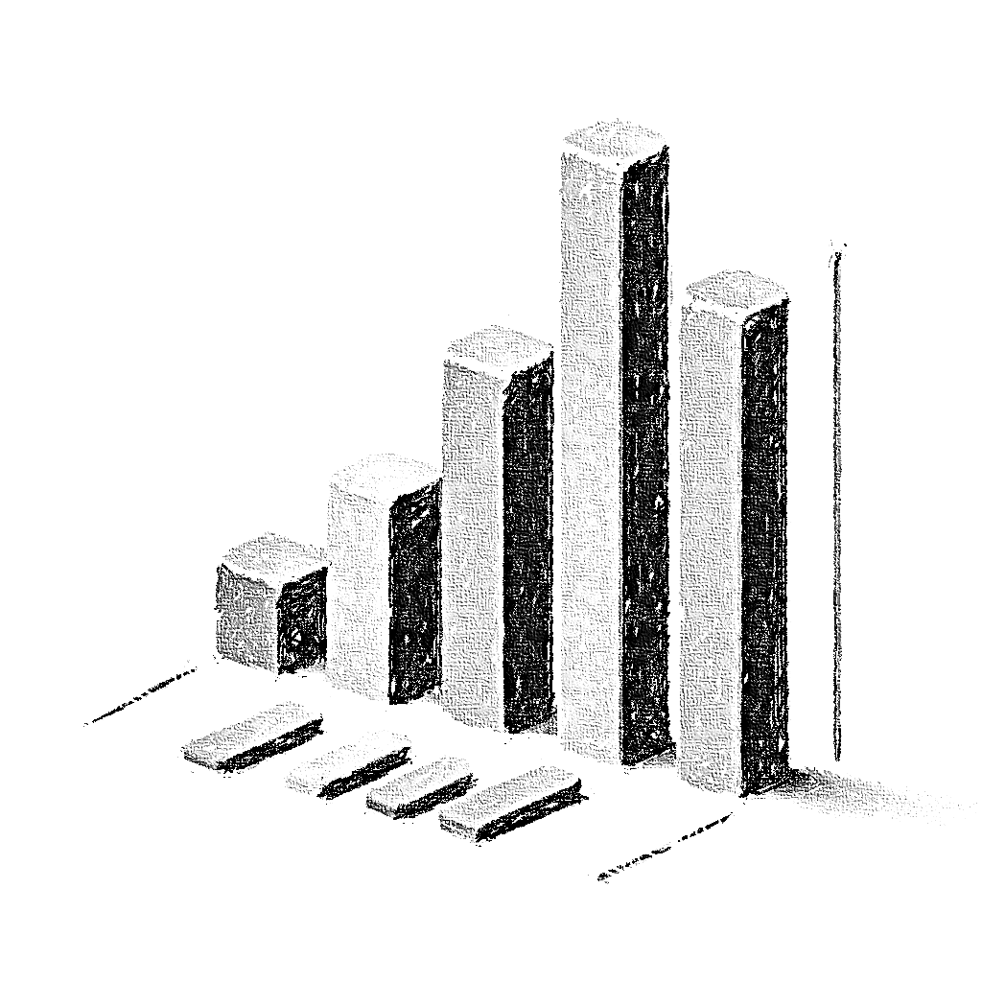
SaaS Product Exploratory Data Analysis: Strategic Optimization for Sustainable Growth
Rizky S.

Slide 2
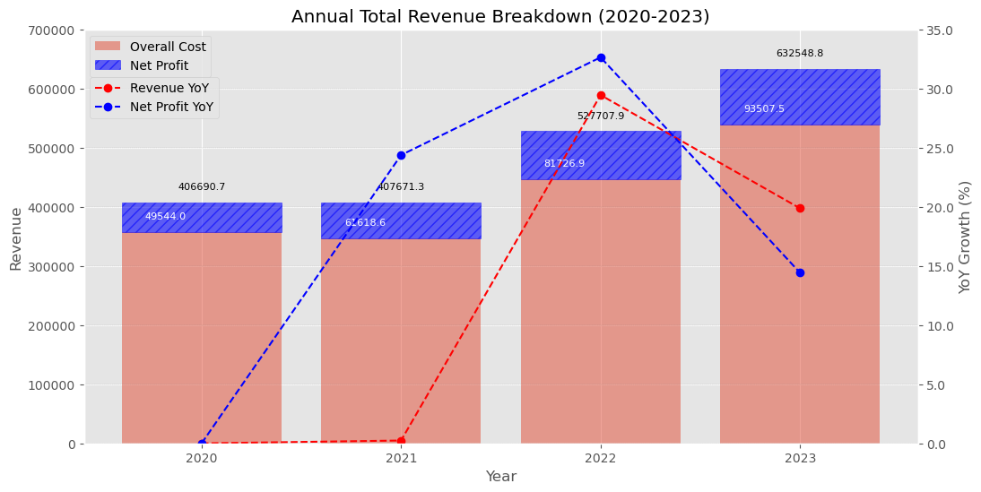
Rapid growth is exciting but requires strategic optimization to avoid inefficiencies and ensure sustainable, long-term success.
In 2021 and 2022, net profit growth outpaced revenue growth with respective increases of 24.37% and 32.63% versus revenue growth of 0.24% and 29.44%. However, in 2023, this trend reversed with revenue growing by 19.87% and net profit growth slowing to 14.41%, suggesting rising costs or operational inefficiencies impacting the ability to convert revenue into profit as effectively as before.
The Rule of 40 is a key SaaS industry metric that evaluates company health by ensuring combined year-over-year revenue growth and profit margin total at least 40%. This rule helps assess the growth potential of SaaS companies.
2020
Revenue Growth: N/A (base year)
Net Profit Margin: Net Profit / Revenue = 49,543.9741 / 406,690.7027 ≈ 12.17%
Rule of 40: Not applicable for base year
2021
Revenue Growth: 0.24%
Net Profit Margin: 61,618.6037 / 407,671.3237 ≈ 15.12%
Rule of 40: 0.24% + 15.12% = 15.36% (Below 40%)
2022
Revenue Growth: 29.44%
Net Profit Margin: 81,726.9308 / 527,707.8887 ≈ 15.49%
Rule of 40: 29.44% + 15.49% = 44.93% (Above 40%)
2023
Revenue Growth: 19.87%
Net Profit Margin: 93,507.5131 / 632,548.8109 ≈ 14.78%
Rule of 40: 19.87% + 14.78% = 34.65% (Below 40%)

Slide 3
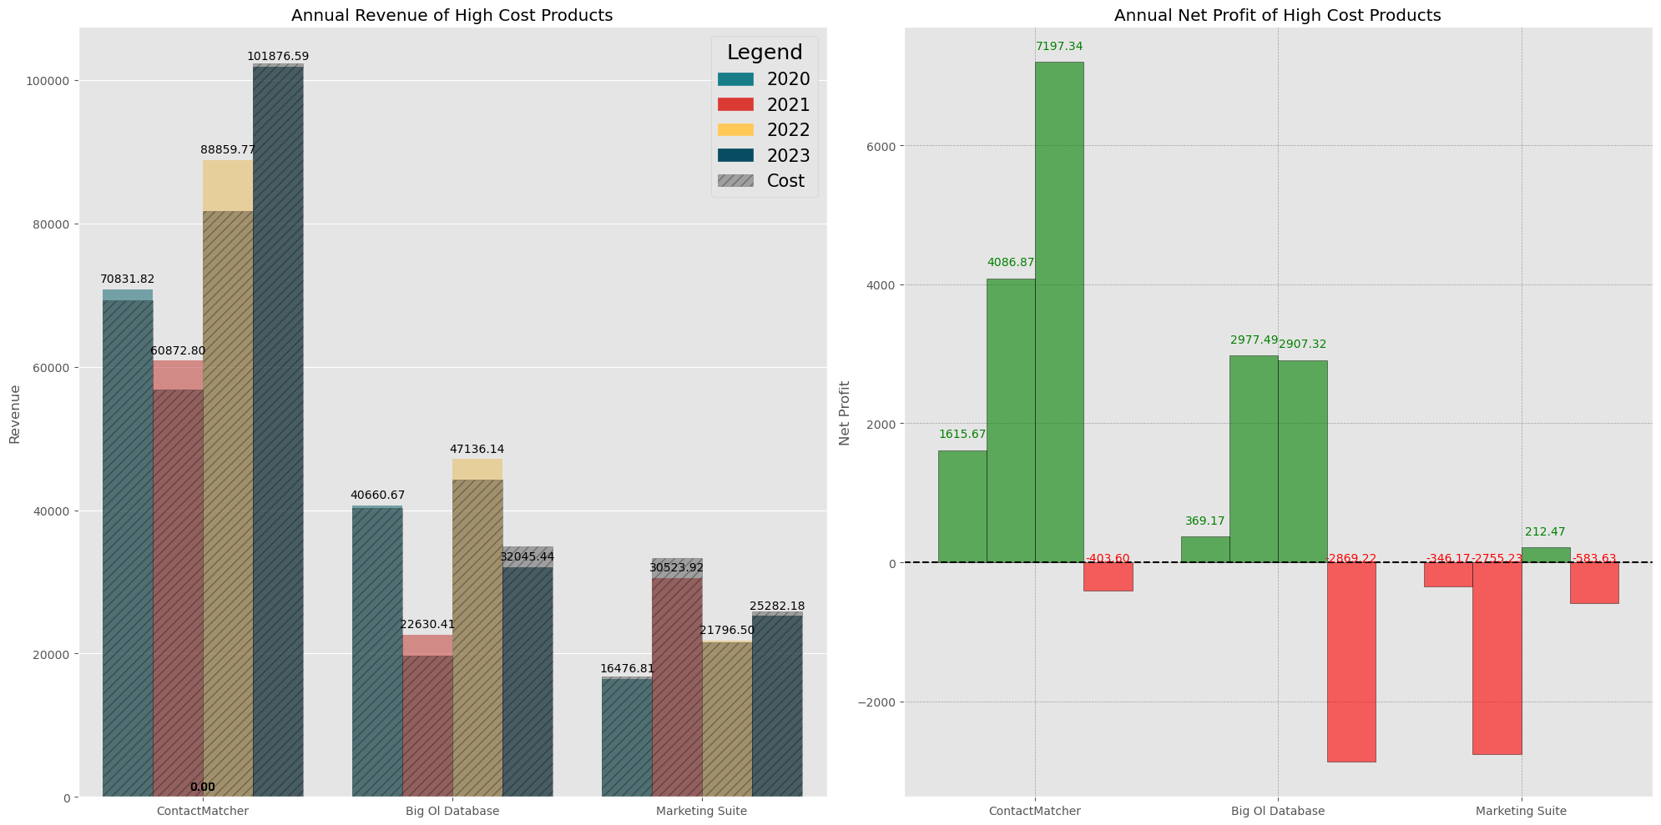

In 2023, three products face high costs that impact the company’s overall profitability: ContactMatcher, Big Ol Database, and Marketing Suite.
In 2023, total annual net profits highlight significant financial challenges: ContactMatcher at -$403.60, Big Ol Database at -$2,869.22, and Marketing Suite at -$583.63.
ContactMatcher
Has consistently achieved the highest revenue among all 14 products, generating $101,876.59 in revenue in 2023. However, with costs reaching $102,280.19, this resulted in a negative net profit margin of -0.4%.
Big Ol Database
Has fluctuating revenue, with profit margins declining from 13% in 2021 to 6% in 2022, and hitting -9% (-$2,869.22) in 2023, the highest loss of all 14 products. High costs have outpaced revenue, resulting in declining profitability over time.
Marketing Suite
Has consistent high costs that outweigh its revenue generation capabilities, resulting in mostly negative profit margins. Specifically, the profit margins were -2% in 2020, -9% in 2021, 1% in 2022, and -2% in 2023.

Slide 4
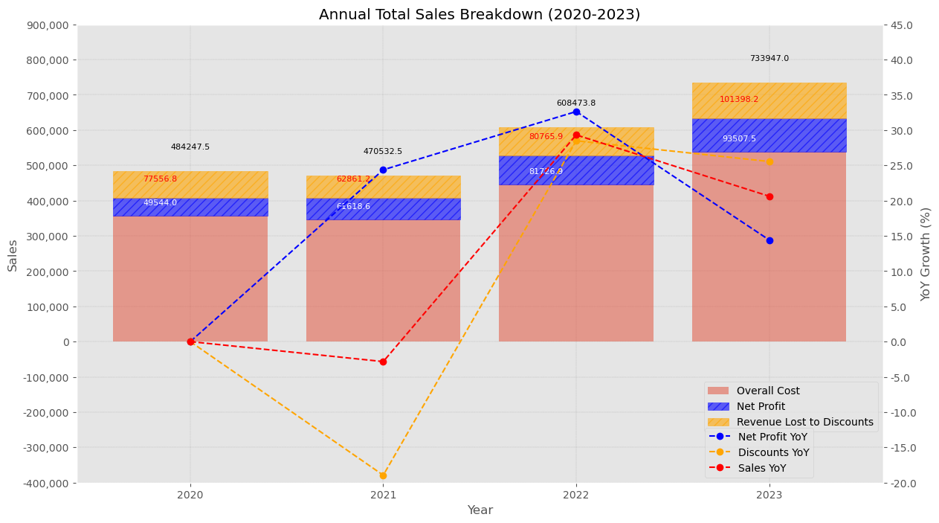
Aggressive discounting strategies in 2023 led to diminishing returns on profitability.
While discounts boosted sales growth (Sales Year-over-Year at 20.6%), they slowed profit growth (Net Profit YoY at 14.4%). With Discounts YoY rising to 25.5%, the gap between sales and profit growth widened, suggesting that further discounting could harm profitability.
This chart shows a strong positive correlation between "Discounts YoY" and "Sales YoY". Increases in discounts generally led to increases in sales volumes. However, the relationship between Net Profit YoY Growth and Discounts YoY indicate potential diminishing returns from aggressive discounting strategies.
In 2021, there was a big gap between Net Profit YoY growth (24%), Discounts YoY (-18.95%), and Sales YoY (-2.8%), indicating that reducing discounts helped manage costs effectively.
In 2022, the values were closely aligned with Net Profit YoY (32.6%), Discounts YoY (28.5%), and Sales YoY (29%), showing that increased discounts had drove both sales and profit growth.
However, in 2023, the gap widened again with Net Profit YoY growth slowing to 14.4%, while Discounts YoY (25.5%) and Sales YoY (20.6%) rose, suggesting that aggressive discounting began to yield diminishing returns on profitability.

Slide 5
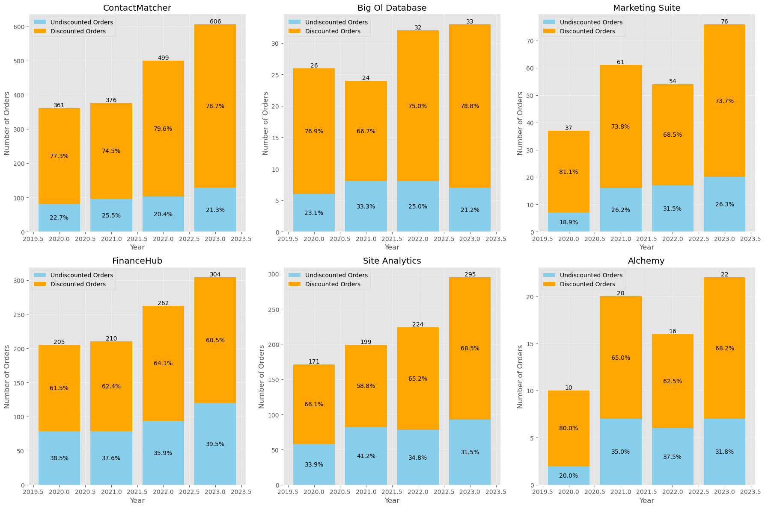
For some products, the majority of orders are discounted. This indicates that customers of these products are more cost/price-sensitive.
Cost-sensitive products presents several challenges:
1) Price Elasticity: These products typically have high price elasticity of demand, meaning that a small price change leads to a large change in the quantity demanded. Reducing discounts might significantly decrease sales numbers.
2) Consumer Behavior: Customers of cost-sensitive products tend to be more price-conscious and frequently compare prices or switch brands to find better deals. Reducing discounts might make users switch to alternatives.
3) Market Competition: The market for cost-sensitive products is highly competitive, with businesses striving to offer the best prices to attract customers. This often leads to a price war in the market.

Slide 6
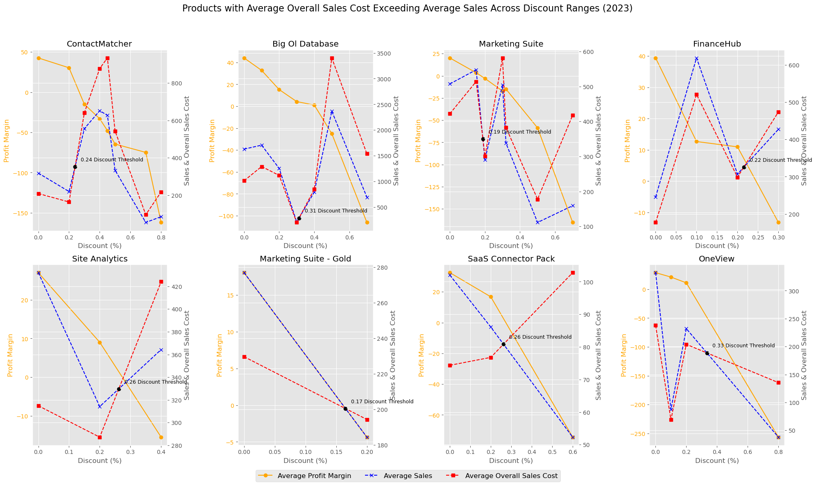
Some products utilize various discount ranges which have led to net profit losses.
ContactMatcher, Big Ol Database, Marketing Suite, FinanceHub, Site Analytics, Marketing Suite - Gold, SaaS Connector Pack, and OneView all utilize various discount ranges on each order/invoice. On average, these discounted orders result in negative profit margins when the discounts exceed specific thresholds.
Aggressive and varied discount ranges decrease profitability, as shown in the 8 products charted to the left. These products' Average Overall Sales Cost exceeds the Average Sales generated, with profit margins turning negative when discounts surpass the break-even point:
ContactMatcher: 24% Discount
Big Ol Database: 31% Discount
Marketing Suite: 19% Discount
FinanceHub: 22% Discount
Site Analytics: 26% Discount
Marketing Suite - Gold: 17% Discount
SaaS Connector Pack: 26% Discount
OneView: 33% Discount

Slide 7
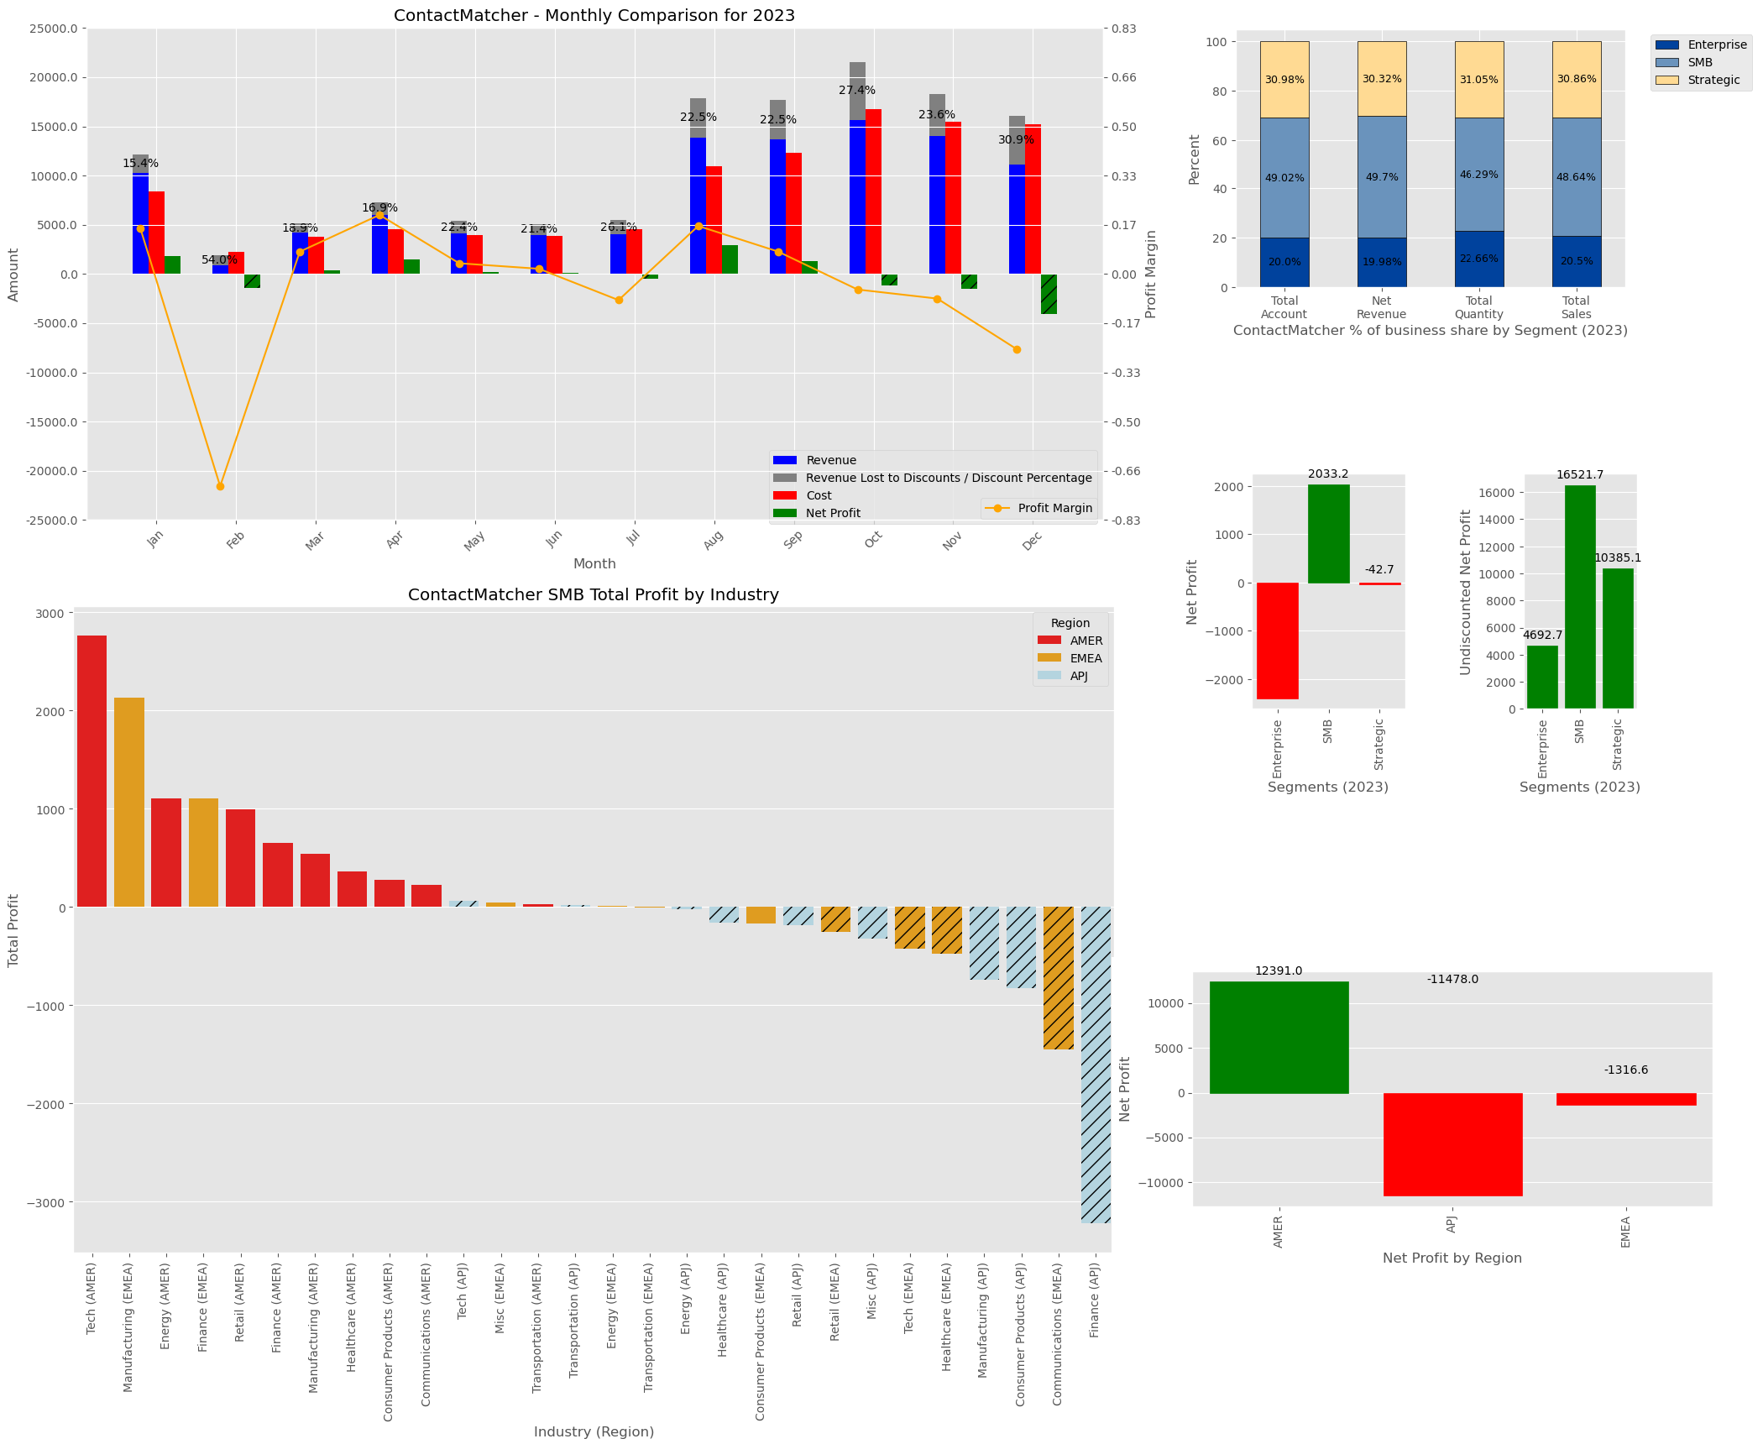

Cost Management: Especially for high-cost products, it is necessary to identify areas of inefficiency.
Analyzing costs and identifying seasons, segments, and regions where costs exceed revenue can pinpoint inefficiencies. This can provide insights to optimize pricing and enhance profitability without over-relying on discounts.
As demonstrated in the ContactMatcher example to the left, identifying high-cost seasons, profitable segments, regions, and costly industries is achievable with the dataset. Based on the data:
December shows the highest negative profit, indicating year-end issues or increased costs. While revenue and profit margin decline, discounts saw an increase in December, at 30.9%, way above the 24% average threshold.
Strategic and Enterprise segments are losing profit, with the Strategic segment showing a loss of -$42.70 and the Enterprise segment incurring a high loss of -$2,394.15. Meanwhile, SMBs contribute significantly to ContactMatcher, driving 49.70% of net revenue and 48.64% of sales, with a net profit of $2,033.25.
In the SMB segment, focus marketing efforts on Tech and Energy in AMER, and Manufacturing and Finance in EMEA, as they perform best. Finance in APJ, Communications in EMEA, Consumer Products in APJ, and Manufacturing in APJ are high-risk, losing money, and require revised discount strategies. Smart measures should balance revenue and profitability, considering operational costs and marketing efforts.

Slide 8
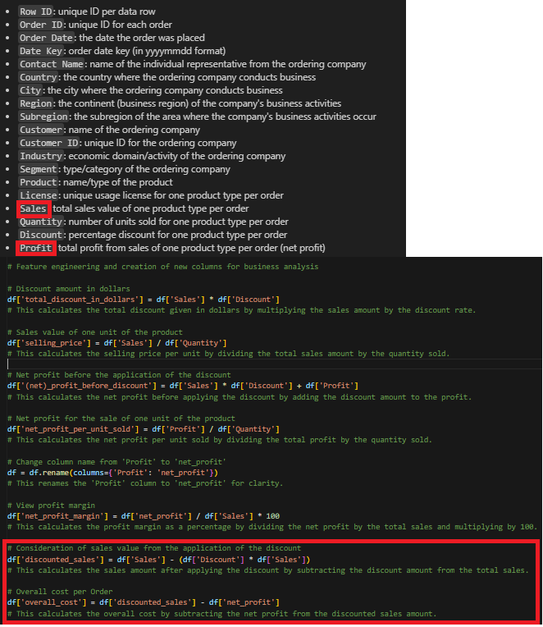
Dataset Limitation: Lack of detailed cost data in the dataset makes it challenging to accurately assess profit and profitability.
While net profit provides a comprehensive view, it combines all expenses, which can distort real-world insights and hinder decisions related to cost management, such as customer acquisition cost (CAC) and discount optimization. To address this, it is essential to collect and integrate detailed cost data, including the cost of goods sold (COGS) and customer acquisition costs (CAC). This would enable the calculation of key metrics like the LTV:CAC ratio, which is vital for evaluating the efficiency of customer acquisition efforts in SaaS. Alternatively, gathering both gross profit and net profit data allows for a more precise analysis of profitability by separating production costs from other operational expenses.

Slide 9
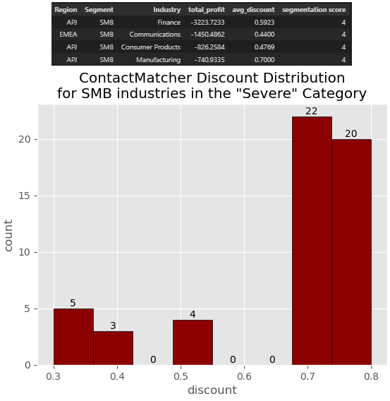
It’s important to evaluate the long-term sustainability of aggressive discounting practices to ensure they drive sales without significantly harming profit margins.
For high-cost products like ContactMatcher, it's crucial to gradually reduce discounted orders, particularly in industries that contribute to profit losses (as shown in the chart to the left).
Instead, emphasize the value proposition and unique features of these products to justify their pricing.

Slide 10
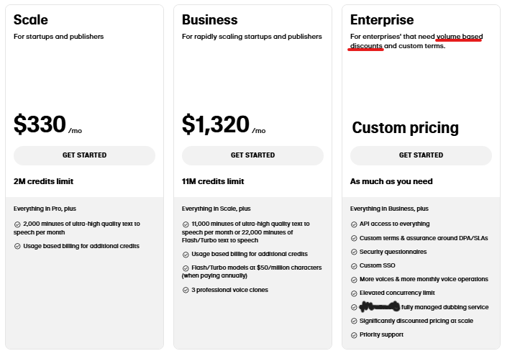
As an alternative for discounting, consider creating entry-level tiers, adding value through extra features or services, and improving marketing segmentation to better target customer groups.
In real-world SaaS businesses, discounts are typically bundled with package options and are not extensively used to boost sales. Below, the package option illustrates how a real-world SaaS business sets prices and discounts for its products.
In the long-run, discounting can lower perceived value of products, attract price/cost-sensitive customers, and create expectations for more deals, impacting profitability.
Research shows that initial purchase discounts can reduce the perceived value of products by at least 12%, while free trials and promotions have a lesser effect.
(Source: https://www.paddle.com/blog/discount-pricing)

